Slide 1
Transformation BPM in Pepsico
Mar’2020

Slide 2

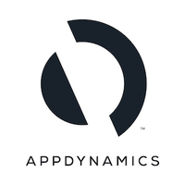
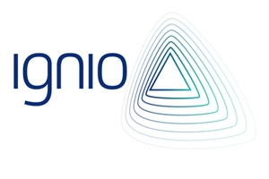
Transformation Journey
Kick Started the Pilot Use Case using ELK BPM
Implemented O2C use case successfully in collaboration with AppD BIQ PS team, however, it involved heavy costing for licensing BIQ Agents
1
3
1
Initial solution was proposed by Digitate & EIS teams using Ignio. However, couldn’t advance as Ignio was ineffective to build BPM
2
1
1

Slide 3












PBNA Order-to-Cash –AIOps enabled Platform
Stage - 1
OPERATIONS
Implementation using Ignio
CMDB
Blueprint
Anomaly Detection, Service Request Automation
Incident Management
Self-heal
Health Checks,
Correlation
ITSM
Auto Discovery, Performance, Availability
Users
WEB
EDI
SAP
MIDDLEWARE
DB
MF
Development
Test
Release
PepsiCo Hybrid IT Infrastructure & Applications
Cloud
Network
Storage
Compute
Hybrid IT
Applications

Slide 4
Stage - 2
Implementation using AppD BIQ

Slide 5
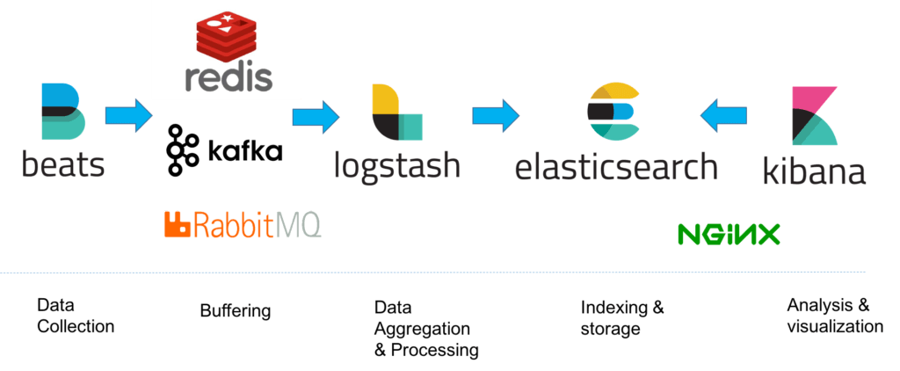
Why Elastic Stack ?
Centralize Log
Monitoring
Log aggregation in a central location
Ease of data search
Data capture from Client application using Beats
1
Business Transaction Monitoring
End-to-End flow monitoring in dashboard
Rapid identification of Slow/delayed transaction
Minimized Business Impact
2
Beats : Beats are lightweight data shippers, installed as agents on servers to send disparate types of data to Kafka
Logstash : A Log pipeline tool execute different transformations and exports the data to Elasticsearch
Elasticsearch : A RESTful distributed search engine built on top of Apache Lucene
Kibana : An open source data visualization and exploration tool from that is specialized for large volumes of streaming and real-time data
APM & Metrics
Monitoring
System Metrics Visualization
Proactive monitoring of JVM, Heap Memory issues
3
Licensing
Open source (excluding x-pack features)
On Par with market leaders like AppD, Splunk etc.
4
4

Slide 6
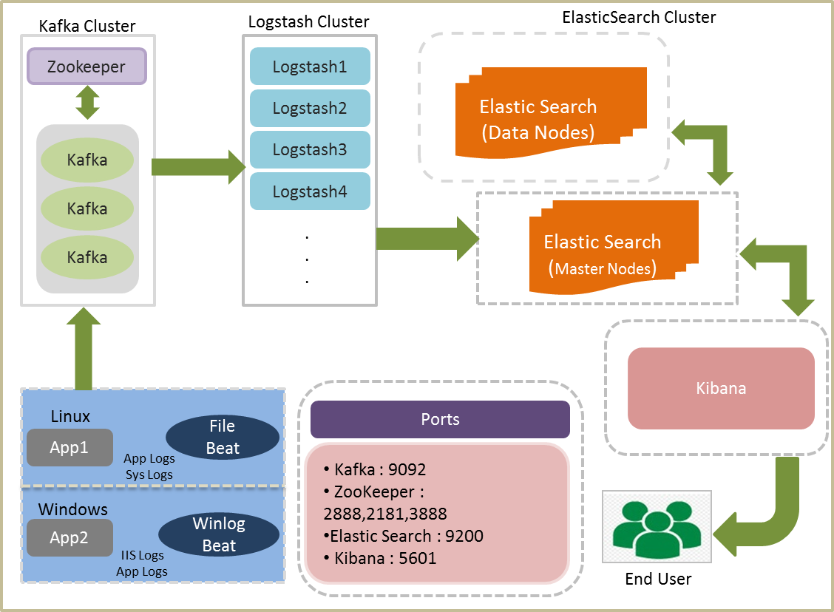
ELK Logical Architecture

Slide 7



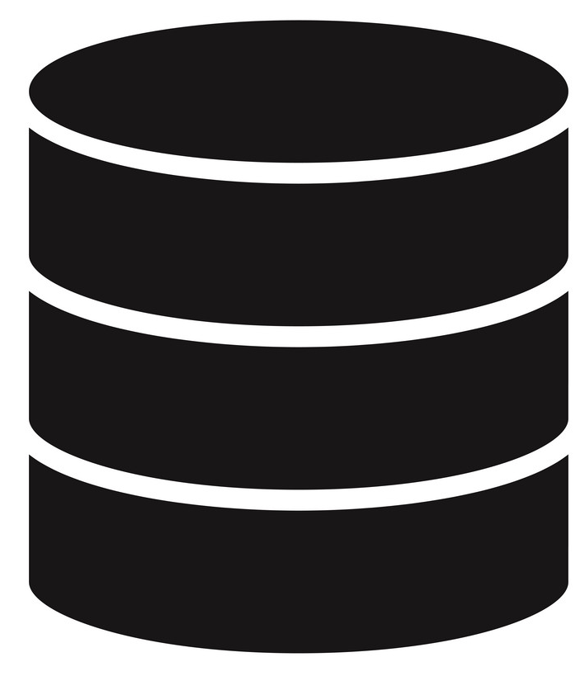
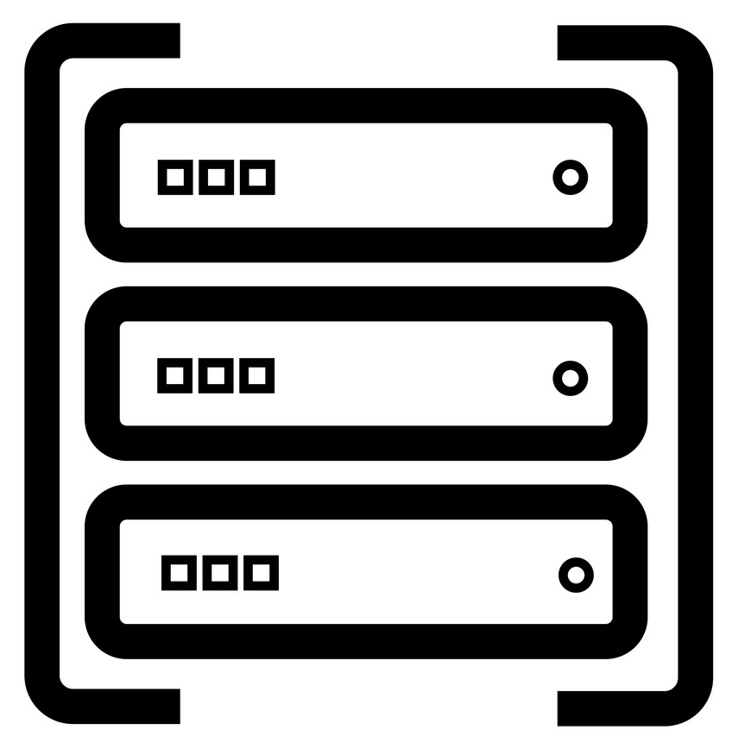
Application Selection Guidelines
Elastic Stack selection
Current Challenges in PepsiCo
Applications should have logging information
Logging information is discrete
DB Tables can be used to capture datasets
Beats can be hosted only on Windows/Linux platform
Apps are hosted on non Windows/Linux Platform
NAS storage or Kafka broker can be leveraged
Beats are necessary for effective monitoring
No Beats are allowed on critical applications
CollectD can be hosted as a root process
Only Reports DB access is allowed
Near real time replication need to be enabled
JDBC connections used for ingesting DB data
Application servers like IIS, Apache tomcat, WebLogic, Wildfly etc.
JAR files are directly executed using Autosys
JVM monitoring requires manual monitoring

Slide 8
ASN Workflow Monitoring – Paradigm Shift
Conventional Approach
To Be
Post to Order Certification, Invoicing is kicked off followed by ASN generation for respective ASN participants using Autosys batch jobs​
At times ASNs are not generated due to different reasons as flow involves multiple systems (EMS Queue, ECG, Trading Partner)​
Monitoring of individual system is cumbersome which leads to identification of failures on reactive basis which inturn impacts the business
Owing to potential significance of ASN delivery to Trading Partner, Elastic Stack leverages holistic business view in Kibana dashboard​
It substantiates failures to be monitored at every individual system on a proactive basis​

Slide 9
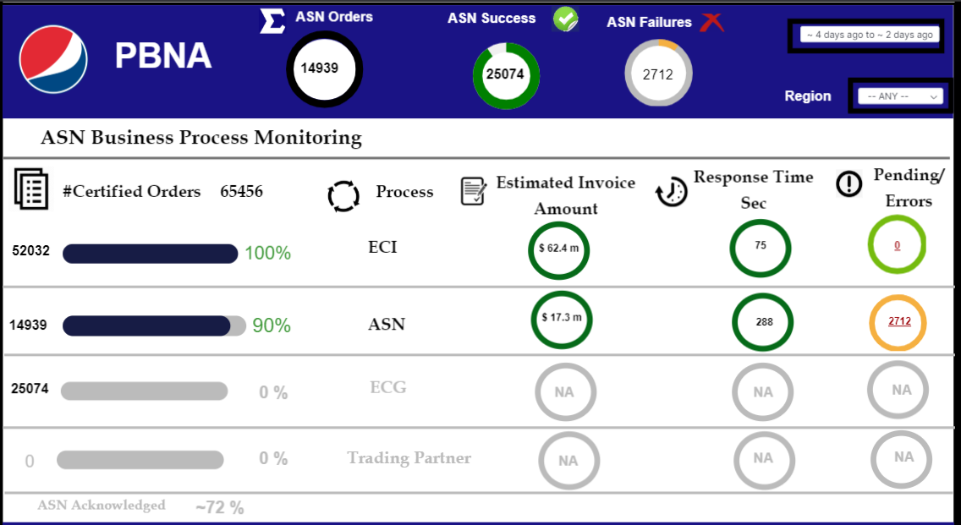
Kibana Dashboard - ASN BPM 1

Slide 10
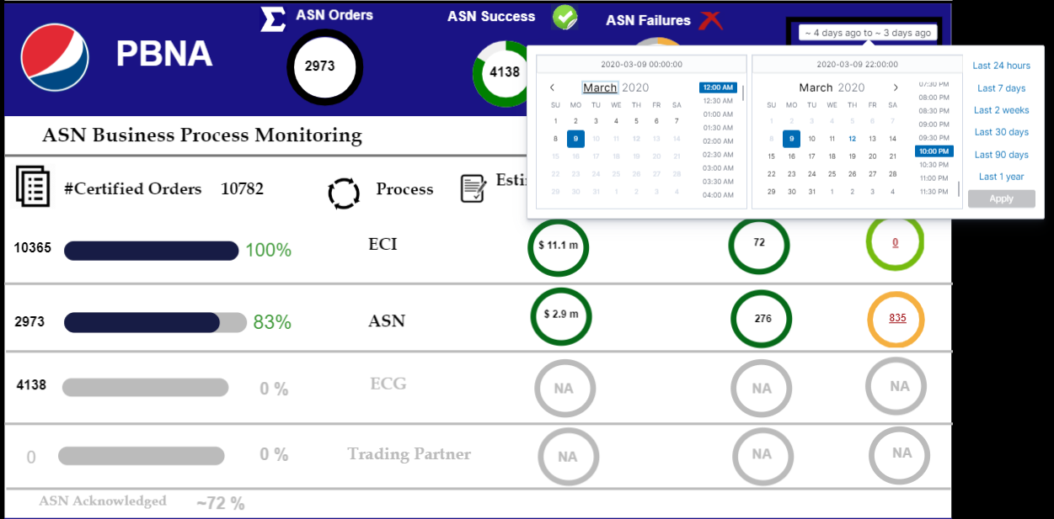
Kibana Dashboard - ASN BPM 1

Slide 11
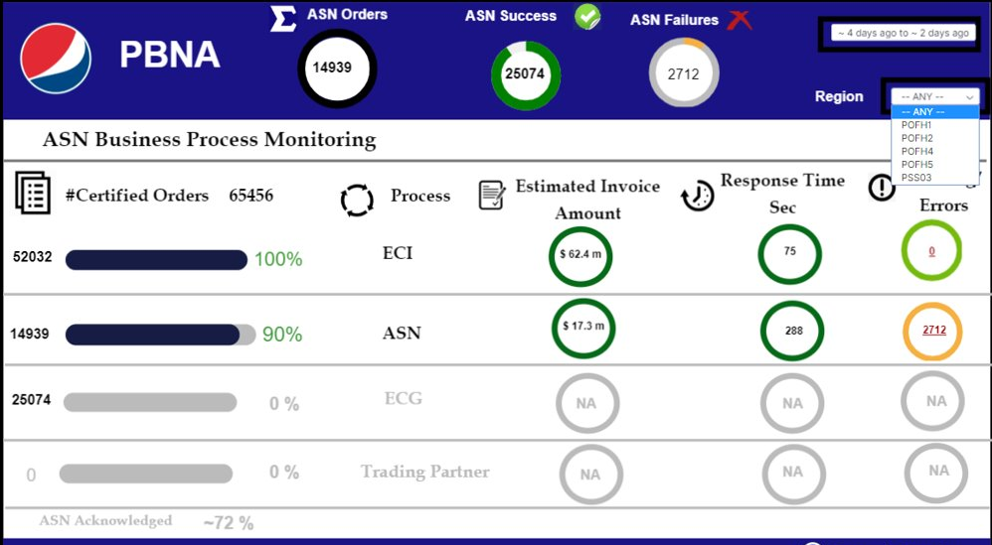
Kibana Dashboard - ASN BPM 1

Slide 12
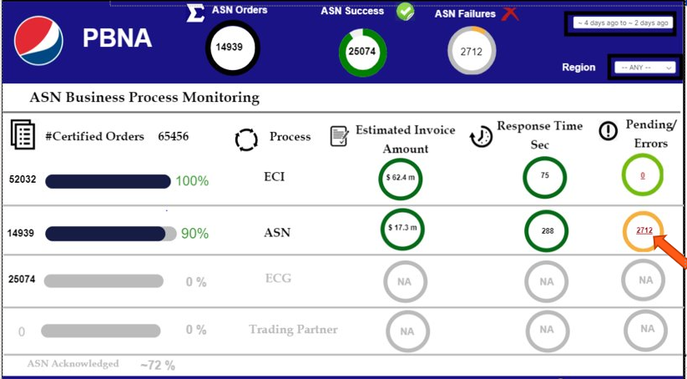
Kibana Dashboard - ASN BPM 1

Slide 13
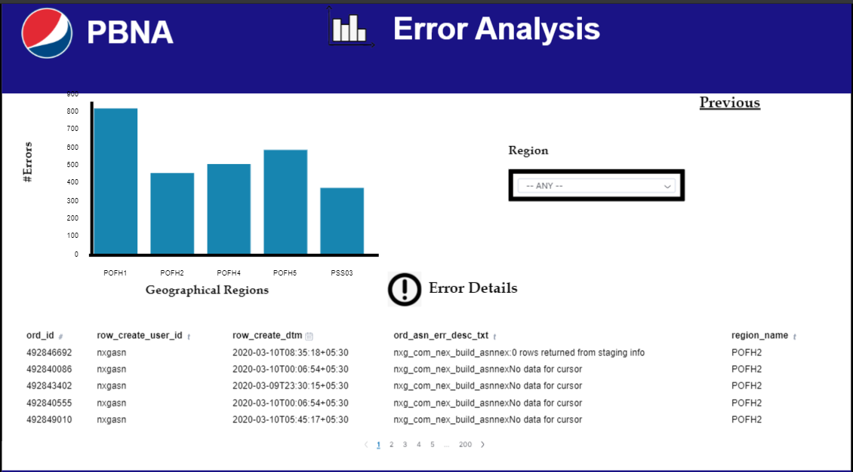
Kibana Dashboard - ASN BPM 2

Slide 14
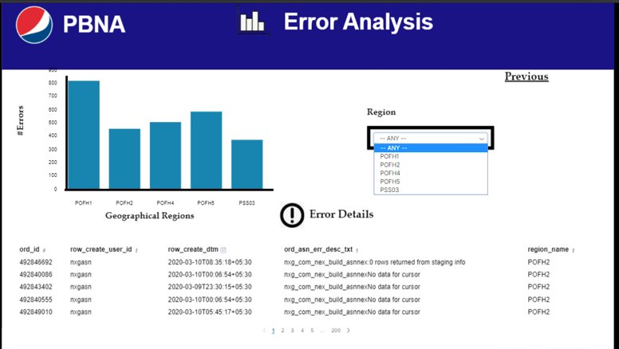

Slide 15
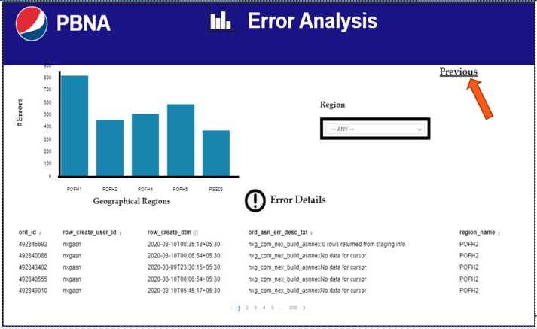
Kibana Dashboard - ASN BPM 2

Slide 16
Thank You

